Slide 1
Bank Loan Bot
Prediction Of Loan Approval

Slide 2
Table Of Contents
1. Inside The Bank Loan Bot
2. Data Collection And Processing
3. Exploratory Data Analysis
4. The Models Used
5. Metrics
6. ROC Curves And Shap Values

Slide 3

Inside The Bank Loan Bot
Given a set of features will an applicant be granted for approval for a loan from the bank.
Classification problem.

Slide 4
Value Of This Project
Confusion Matrix
Save time looking at loan applications that can be approved without investigation or visual confirmation.
Pay for labor in dealing only with loans that are rejected by bots due to their predictions.
Good to be aware of why an applicant can’t get a mortgage approval.
 | Actual
Predicted | True Positive | False Positive
 | False Negative | True Negative

Slide 5
Data Collection And Processing
13 Features presented and each feature is described in the figures below.
1 target variable; Loan_Status.
The dataset came from Kaggle.
The datasets were split into separate csv files one for training and the other for testing.
The testing set designed for submission of your results from the model created.
Mixed data types and some wrangling necessary.

Slide 6
Wrangling Steps Used
Convert all numerically measurable features to float64 – correlation heatmap.
Imputation of missing values.
Quantize the target variable and some of the independent variables into 0’s and 1’s (Education, Self Employed, Gender, Married).
Replace ‘3+’ value in the Dependents variable with ‘3.’

Slide 7
Exploratory Data Analysis
Presented Variables
Loan ID
Gender
Married
Dependents
Education
Self-Employed
Credit History
Property Area
Applicant Income
Co-applicant Income
Loan Amount
Loan Amount Term
Loan Status
Engineered Features
Applicant Income Bin
Co-Applicant Income Bin
Total Income Bin
Loan Amount Bin

Slide 8
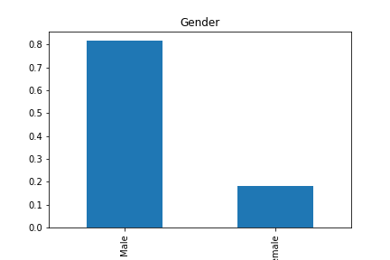
Gender
There were more males than females.

Slide 9
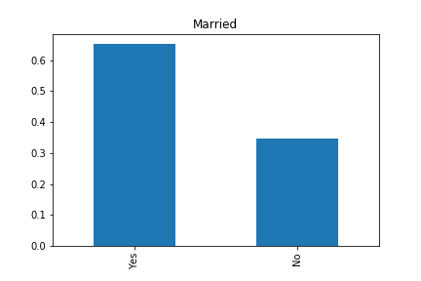
Married
More applicants are married.

Slide 10
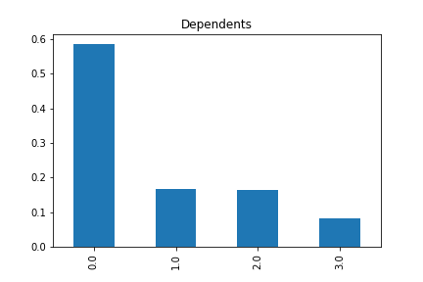
Dependents
The Majority of applicants have no dependents.

Slide 11
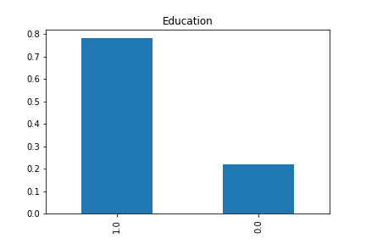
Education
The majority of applicants are graduates.

Slide 12
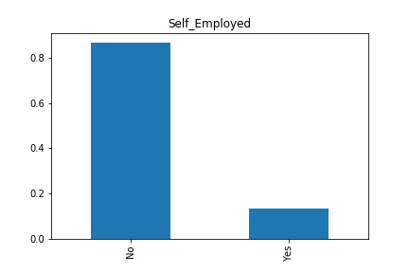
Self-Employed
The majority of applicants are not self-employed.

Slide 13

Credit History
The majority of applicants have good credit history.
Credit history in this data is binary; good credit is a 1.0 and bad credit is a 0.0.

Slide 14
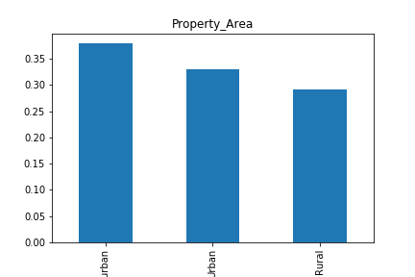
Property Area
No missing values for property area.
Distribution is fairly even with the most applicants coming from urban areas.

Slide 15
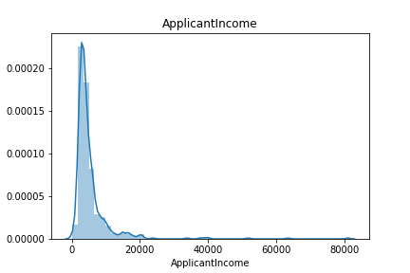
Applicant Income
Near normal distribution with a right tail.
High outliers to the right.
Can be moderated by taking the logarithmic scale.

Slide 16
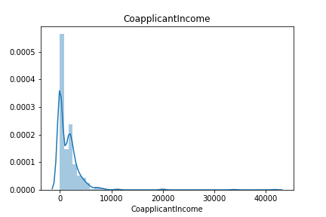
Co-Applicant Income
Same in nature as Applicant Income.

Slide 17
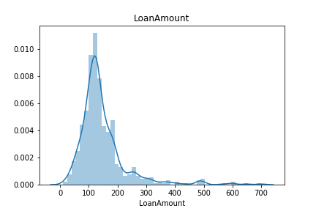
Loan Amount
Same pattern in nature as Applicant and Co-applicant income.

Slide 18
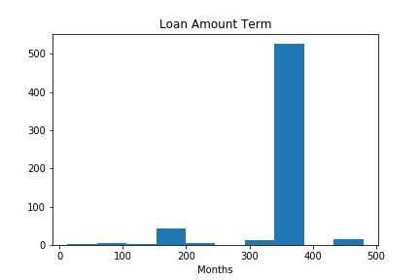
Loan Amount Term
Most applicants have a Loan Amount Term of 360 months.
This is quite an obvious mode, made imputing missing values for this column easy.

Slide 19
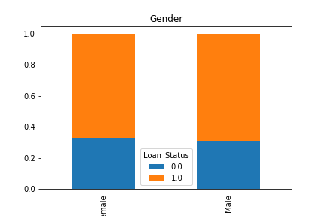
Gender vs Loan Status
Loan approval ratings are the same regardless of gender.

Slide 20
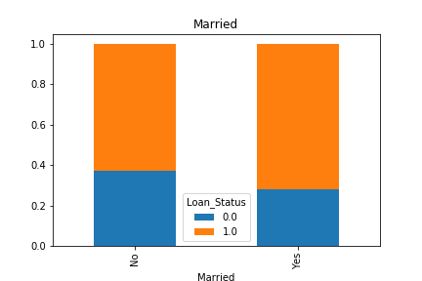
Married vs Loan Status
Applicants who are married have a slightly higher approval rating.

Slide 21
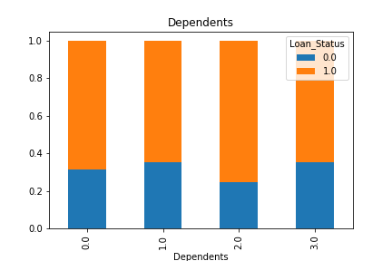
Dependents vs Loan Status
No clear relationship between number of dependents and loan approval rating.

Slide 22
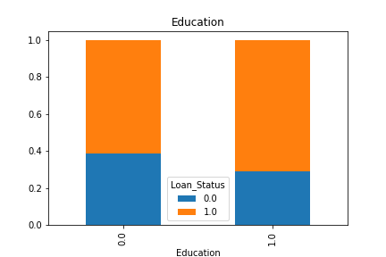
Education vs Loan Status
More loans are granted to applicants who are considered graduate or educated.

Slide 23
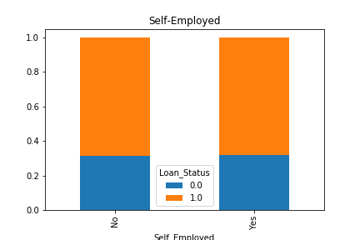
Self-Employed vs Loan Status
No obvious relationship here between whether or not an applicant is self-employed/loan approval.

Slide 24
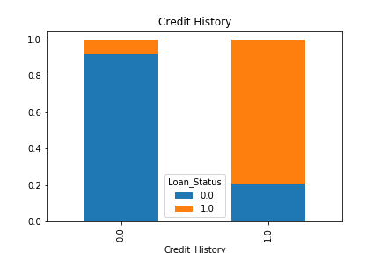
Credit History vs Loan Status
Applicants with good credit history have significantly higher approval rating.

Slide 25
Binning
As part of the EDA, numerical columns like applicants’ incomes and loan amount were binned.
Some relationships become clear when certain columns are binned.

Slide 26
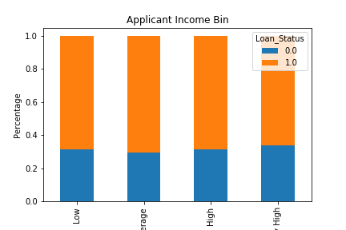
Applicant Income Bin
No clear relationship between loan status and applicant income.

Slide 27
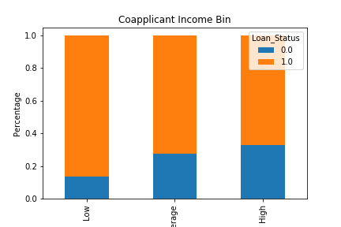
Co-applicant Income Bin
Applicants with co-applicants who have higher incomes generally have lower approval rating.
Income states nothing about an applicant’s will to pay back a loan.

Slide 28
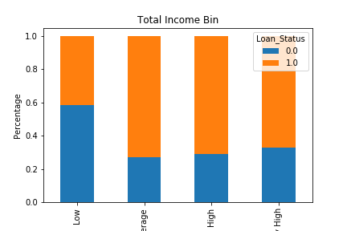
Total Income Bin
Clearer relationship that was hidden in the previous two figures.
Applicants with total incomes from their co-applicants and themselves that are low have lower approval ratings.
Low income = higher risk.
Capacity.

Slide 29
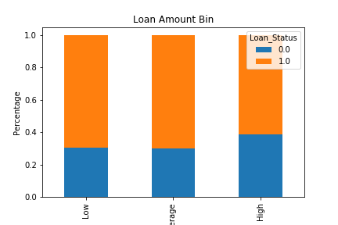
Loan Amount Bin
Loan amount also binned as low, average or high.
Loan amounts that are high have slightly lower approval ratings.
There’s higher risk in lending money to applicants who ask for more money.

Slide 30
Correlations And Patterns
Weak correlation between credit history and loan status (0.57).
Credit history seems to be the biggest determining factor for the target variable.
Weak correlation between applicant income and co-applicant income.
The relationship comes from a periphery cause; applicants tend to marry people of similar incomes levels.

Slide 31
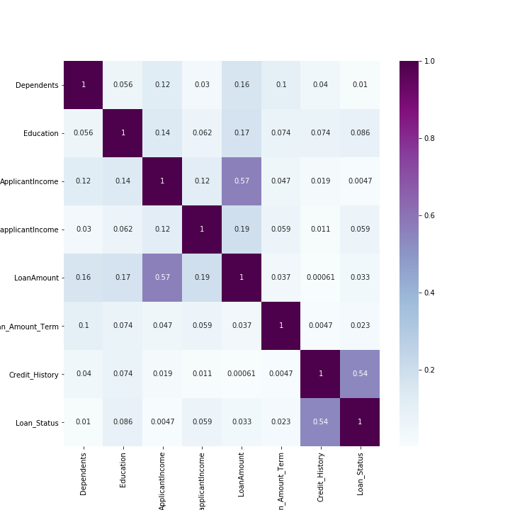
Correlations And Patterns

Slide 32
Best Models Used
Random Forest
GridSearchCV/RandomizedSearchCV
Optimal Number Of Nodes: 3 (from range 0 to 20 tried).
Optimal Number Of Trees Ensembled: 61 (from range 1 to 200 tried).
Logistic Regression
Optimal C value: 0.27

Slide 33
Metrics
Logistic Regression
Random Forest
ROC_AUC = 0.7
Accuracy = 0.78
F1 Score(macro avg) = 0.71
ROC_AUC=0.7
Accuracy=0.78
F1 Score(macro avg)=0.70

Slide 34
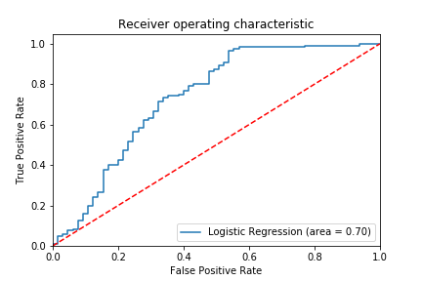
Logistic Regression ROC Curve

Slide 35
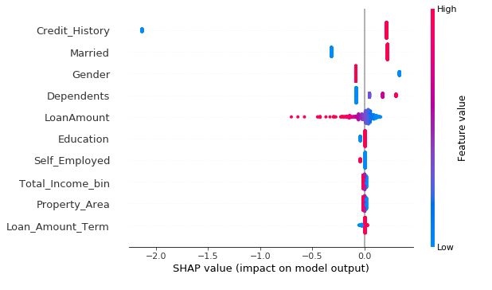
Logistic Regression Shap Values
SHAP value is a contribution each datapoint is making in determining target variable.
Bad credit exhibits the most negative SHAP value.
Credit_History, Married, Gender, Dependents and LoanAmount are the most important features.

Slide 36
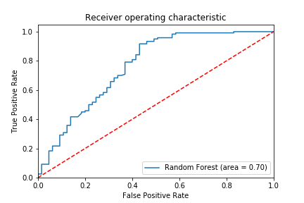
Random Forest ROC Curve

Slide 37
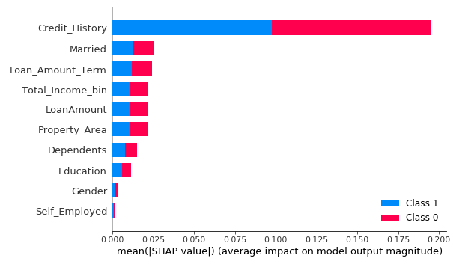
SHAP Values For Random Forest
Credit_History, Married, Loan_Amount_Term, Total_Income_bin, Loan_Amount and Property_Area are the most important features – highest |SHAP value|.
Priority in features different to logistic regression.

Slide 38
The Most Important Variables
Credit History is by far the most important for the two models.
Banks place more importance on features indicating an applicant’s will to pay back a loan as opposed to whether they can.
Married is important because it indicates an applicant’s stability.
Applicants who are more stable are lower risk.
Gender is biased based on distribution
4:1 Applicants are male to female respectively. Therefore there are likely more false positives that are male applicants.
LoanAmount important to banks.
Applicants with lower asking amounts (because they’re buying cheaper property, which may show up in the property Area feature) are lower risk.
Total Income Bin is important in random forest.
As shown in the EDA, applicants with low total income are higher risk due to lower capacity to pay back a loan.

Slide 39
Project Improvement And Future Scope Of Work
Hypertuning of the XG boost model so that it out performs the random forest.
Observe the SHAP values from XG boost and determine which way of prioritizing SHAP value emerges as truth in comparing random forest to logistic regression.
Create a new project with present data like this one and find out how things have changed.
Is there still a gender discrepancy? Is credit history as important as it was? Are there other features that can indicate measurements today’s features of interest like capacity and character.

